Slide 1
Cryptography
Encryption techniques are useful to provide the confidentiality to the data.
Encryption tech. are classified into two types:
- Block encryption tech.
- Stream encryption tech.
The Classification is based on number of bits processed at a time.
In Block Cipher, a block of fixed number of bits is processed at a time . It is faster than stream cipher eg. DES
In stream Cipher, one bit is processed at a time. Eg.RC4
In block cipher , the size of the plaintext block and ciphertext block is same.
When the number of bits in the plain text are not multiple of the size of block size, then the technique is called modes of operation.

Slide 2
There are various modes of operatiopn such as
ECB( electrinic code book
CBC (cipher block chaining)
Feedback modes
And COUNTER mode

Slide 3
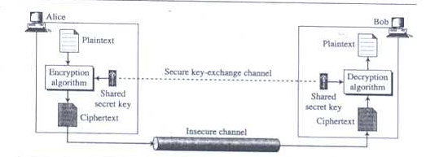
Unit –II Cryptography
Symmetric Key Algorithm
Introduction
Diagram shows general idea behind a symmetric key cipher

Slide 4
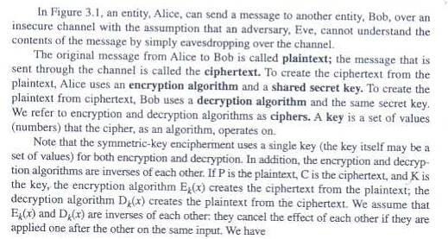

Slide 5
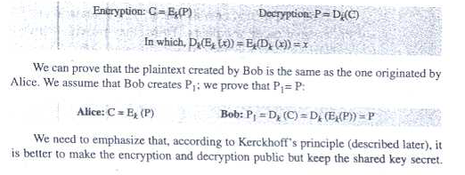
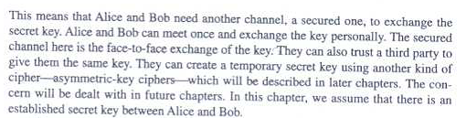

Slide 6
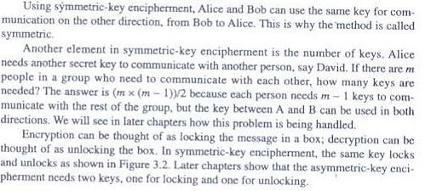

Slide 7
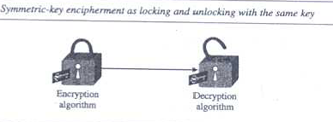
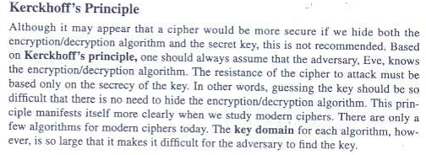

Slide 8

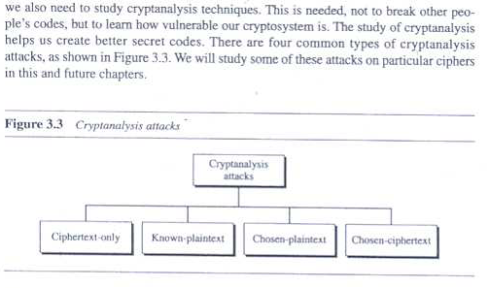

Slide 9
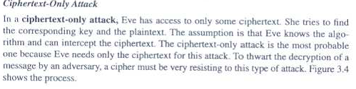
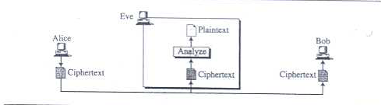

Slide 10


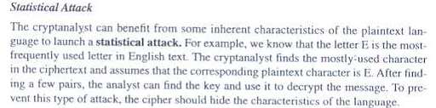

Slide 11

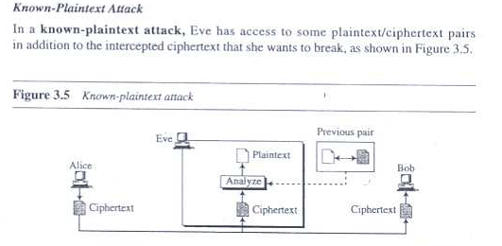

Slide 12
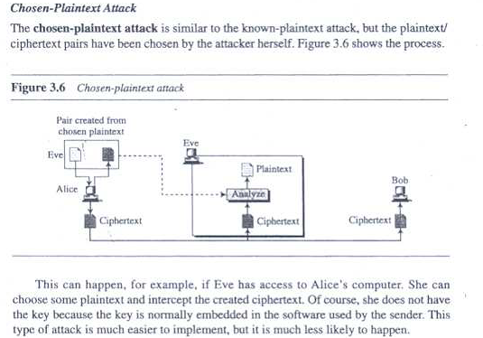

Slide 13
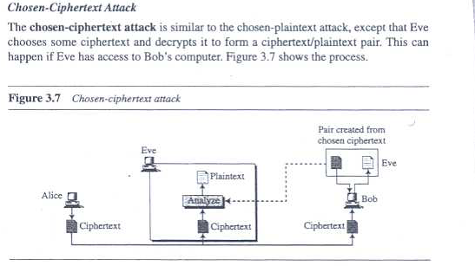

Slide 14
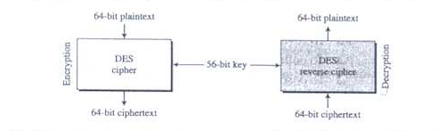
DES: Data Encryption Standard
The Data Encryption Standard (DES) is a symmetric-key block cipher published by the National Institute of Standards and Technology(NIST)
DES is a block cipher as shown in figure:

Slide 15
At the encryption site, DES takes a 64-bit plaintext and creates a 64-bit cipher text;
At the decryption site, DES takes a 64-bit ciphertext and creates a 64-bit block of plaintext.
The same 56-bit cipher key is used for both encryption and decryption.
In the May 15, 1973 Federal Register, the NBS issued a public request for proposals for a standard cryptographic algorithm. They specified a series of design criteria:
— The algorithm must provide a high level of security.
— The algorithm must be completely specified and easy to understand. — The security of the algorithm must reside in the key; the security should not depend on the secrecy of the algorithm.— The algorithm must be available to all users.
— The algorithm must be adaptable for use in diverse applications.— The algorithm must be economically implementable in electronic devices.— The algorithm must be efficient to use.— The algorithm must be able to be validated.
— The algorithm must be exportable.

Slide 16
Description of DES
DES is a block cipher; it encrypts data in 64-bit blocks.
A 64-bit block of plaintext goes in one end of the algorithm and a 64-bit block of ciphertext comes out the other end.
DES is a symmetric algorithm:
The same algorithm and key are used for both encryption and decryption (except for minor
differences in the key schedule).
The key length is 56 bits. (The key is usually expressed as a 64-bit number, but every eighth bit is used
for parity checking and is ignored. These parity bits are the least-significant bits of the key bytes.)

Slide 17
The key can be any 56-bit number and can be changed at any time.
A handful of numbers are considered weak keys, but they can easily be avoided. All security rests within the key.
At its simplest level, the algorithm is nothing more than a combination of the two basic techniques of
encryption: confusion and diffusion.
The fundamental building block of DES is a single combination of these techniques (a substitution followed by a permutation) on the text, based on the key.
This is known as a round. DES has 16 rounds; it applies the same combination of techniques on the plaintext block 16 times.

Slide 18
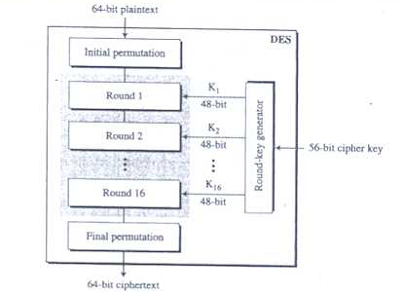
General Structure of DES

Slide 19
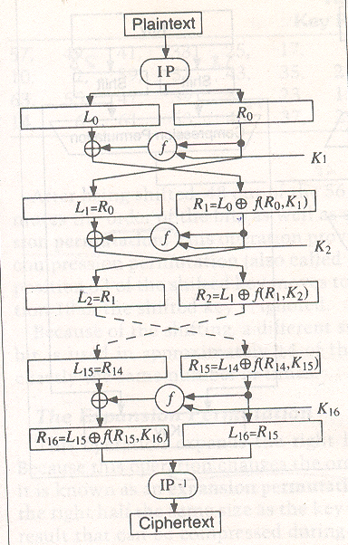
DES

Slide 20
The algorithm uses only standard arithmetic and logical operations on numbers of 64 bits at most, so it was easily implemented in late 1970s hardware technology.
The repetitive nature of the algorithm makes it ideal for use on a special-purpose chip. Initial software implementations were clumsy, but current implementations are better.
Outline of the Algorithm
DES operates on a 64-bit block of plaintext. After an initial permutation, the block is broken into a right half and a left half, each 32 bits long.
Then there are 16 rounds of identical operations, called
Function f, in which the data are combined with the key.
After the sixteenth round, the right and left halves are joined, and a final permutation (the inverse of the initial permutation) finishes off the algorithm.

Slide 21
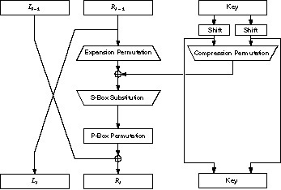
One Round Of DES

Slide 22
In each round (see Figure), the key bits are shifted, and then 48 bits are selected from the 56 bits of the key.
The right half of the data is expanded to 48 bits via an expansion permutation, combined with 48 bits of a shifted and permuted key via an XOR, sent through 8 S-boxes producing 32 new bits, and permuted again.
These four operations make up Function f.
The output of Function f is then combined with the left half via another XOR.
The result of these operations becomes the new right
half; the old right half becomes the new left half.
These operations are repeated 16 times, making 16 rounds of DES.

Slide 23

If Bi is the result of the ith iteration, Li and Ri are the left and right halves of Bi, Ki is the 48-bit key
for round i, and f is the function that does all the substituting and permuting and XORing with the key, then a round looks like:

Slide 24
The Initial Permutation
The initial permutation occurs before round 1; it transposes the input block as described in Table
This table, should be read left to right, top to bottom.
For example, the initial permutation moves bit 58 of the plaintext to bit position 1, bit 50 to bit position 2, bit
Initial Permutation to bit position 3, and so forth.
58, 50, 42, 34, 26, 18, 10, 2, 60, 52, 44, 36, 28, 20, 12, 4,
62, 54, 46, 38, 30, 22, 14, 6, 64, 56, 48, 40, 32, 24, 16, 8,
57, 49, 41, 33, 25, 17, 9, 1, 59, 51, 43, 35, 27, 19, 11, 3,
61, 53, 45, 37, 29, 21, 13, 5, 63, 55, 47, 39, 31, 23, 15, 7

Slide 25
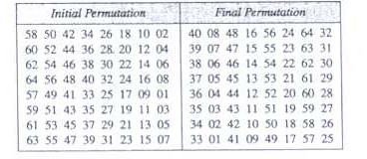

Slide 26
The initial permutation and the corresponding final permutation do not affect DES’s security.
(As near as anyone can tell, its primary purpose is to make it easier to load plaintext and ciphertext data
into a DES chip in byte-sized pieces.
Remember that DES predates 16-bit or 32-bit microprocessor busses.)
Since this bit-wise permutation is difficult in software (although it is trivial in hardware), many software implementations of DES leave out both the initial and final permutations.
While this new algorithm is no less secure than DES, it does not follow the DES standard and should not be
called DES.

Slide 27
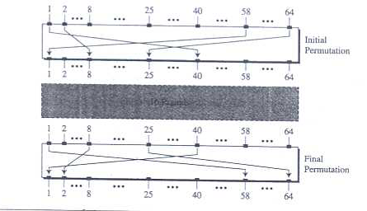
Initial and Final Permutation Steps in DES

Slide 28
The Key Transformation
Initially, the 64-bit DES key is reduced to a 56-bit key by ignoring every eighth bit.
These bits can be used as parity check to ensure the key is error-free.
After the 56-bit key is extracted, a different 48-bit subkey is generated for each of the 16 rounds of DES. These subkeys, Ki are determined in the following manner.
First, the 56-bit key is divided into two 28-bit halves. Then, the halves are circularly shifted left by either one or two bits, depending on the round.

Slide 29
After being shifted, 48 out of the 56 bits are selected. Because this operation permutes the order of the bits as well as selects a subset of bits, it is called a compression permutation.
This operation provides a subset of 48 bits. For example, the bit in position 33 of the shifted key moves to position 35 of the output, and the bit in
position 18 of the shifted key is ignored.
Because of the shifting, a different subset of key bits is used in each subkey.
Each bit is used in approximately 14 of the 16 subkeys, although not all bits are used exactly the same number of times.

Slide 30
The Expansion Permutation
This operation expands the right half of the data, Ri, from 32 bits to 48 bits. Because this operation changes the order of the bits as well as repeating certain bits, it is known as an expansion permutation.
This operation has two purposes: It makes the right half the same size as the key for the XOR operation and it provides a longer result that can be compressed during the substitution operation.
However, neither of those is its main cryptographic purpose.
By allowing one bit to affect two substitutions, the dependency of the output bits on the input bits spreads faster.
This is called an avalanche effect.
DES is designed to reach the condition of having every bit of the ciphertext depend on every bit of the plaintext and every bit of the key as quickly as possible.

Slide 31
Figure defines the expansion permutation. This is sometimes called the E-box.
For each 4-bit input block, the first and fourth bits each represent two bits of the output block, while the second and third bits each represent one bit of the output block. Table shows which output positions correspond to which input positions.
For example, the bit in position 3 of the input block moves to position 4 of the output block, and the bit in position 21 of the input block moves to positions 30 and 32 of the output block.
Although the output block is larger than the input block, each input block generates a unique output
block.

Slide 32
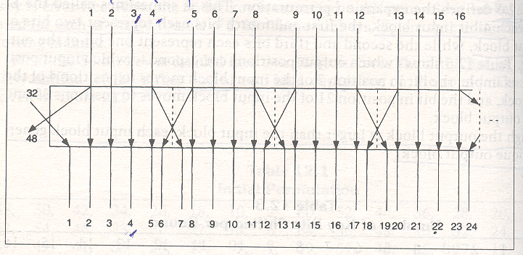
Expansion Permutaion

Slide 33
Expansion Permutation
32, 1, 2, 3, 4, 5, 4, 5, 6, 7, 8, 9,
8, 9, 10, 11, 12, 13, 12, 13, 14, 15, 16, 17,
16, 17, 18, 19, 20, 21, 20, 21, 22, 23, 24, 25,
24, 25, 26, 27, 28, 29, 28, 29, 30, 31, 32, 1

Slide 34
The S-Box Substitution
After the compressed key is XORed with the expanded block, the 48-bit result moves to a substitution operation.
The substitutions are performed by eight substitution boxes, or S-boxes.
Each S-box has a 6-bit input and a 4-bit output, and there are eight different S-boxes. (The total memory requirement for the eight DES S-boxes is 256 bytes.) The 48 bits are divided into eight 6-bit sub-blocks.
Each separate block is operated on by a separate S-box: The first block is operated on by S-box 1, the
second block is operated on by S-box 2, and so on. See Figure .

Slide 35

48 bit input
32 bit output

Slide 36
Each S-box is a table of 4 rows and 16 columns. Each entry in the box is a 4-bit number.
The 6 input bits of the S-box specify under which row and column number to look for the output.
The input bits specify an entry in the S-box in a very particular manner. Consider an S-box input of 6 bits, labeled b1 b2 b3 b4 b5 and b6.
Bits b1 and b6 are combined to form a 2-bit number, from 0 to 3, which corresponds to a row in the table.
The middle 4 bits, b2 through b5 are combined to form a 4-bit number, from 0 to 15, which corresponds to a column in the table.

Slide 37
For example, assume that the input to the sixth S-box (i.e., bits 31 through 36 of the XOR function) is
110011.
The first and last bits combine to form 11, which corresponds to row 3 of the sixth S-box.
The middle 4 bits combine to form 1001, which corresponds to the column 9 of the same S-box. The entry under row 3, column 9 of S-box 6 is 14. (Remember to count rows and columns from 0 and not from 1.)
The value 1110 is substituted for 110011.
It is, of course, far easier to implement the S-boxes in software as 64-entry arrays. It takes some

Slide 38
rearranging of the entries to do this, but that’s not hard. (Don’t just change the indexing without rearranging the entries.
The S-boxes are designed very carefully.) However, this way of describing the S-boxes helps visualize how they work.
Each S-box can be viewed as a substitution function on a 4-bit entry: b2 through b5 go in, and a 4-bit result comes out.
Bits b1 and b6 come from neighboring blocks; they select one out of four substitution functions available in the particular S-box.
The S-box substitution is the critical step in DES.
The algorithm’s other operations are linear and easy to analyze.
The S-boxes are nonlinear and, more than anything else, give DES its security.
The result of this substitution phase is eight 4-bit blocks which are recombined into a single 32-bit block. This block moves to the next step: the P-box permutation.

Slide 39
The P-Box Permutation
The 32-bit output of the S-box substitution is permuted according to a P-box.
This permutation maps each input bit to an output position; no bits are used twice and no bits are ignored. This is called a straight permutation or just a permutation.
For example, bit 21 moves to bit 4, while bit 4 moves to bit 31.
Finally, the result of the P-box permutation is XORed with the left half of the initial 64-bit block.
Then the left and right halves are switched and another round begins.

Slide 40
The Final Permutation
The final permutation is the inverse of the initial permutation .
Note that the left and right halves are not exchanged after the last round of DES; instead the concatenated block R16L16 is used as the input to the final permutation.
There’s nothing going on here; exchanging the halves and shifting around the permutation would yield exactly the same result. This is so that the algorithm can be used to both encrypt and decrypt.

Slide 41
Decrypting DES
After all the substitutions, permutations, XORs, and shifting around, you might think that the decryption algorithm is completely different and just as confusing as the encryption algorithm.
On the contrary, the various operations were chosen to produce a very useful property: The same algorithm
works for both encryption and decryption.
With DES it is possible to use the same function to encrypt or decrypt a block.
The only difference is that the keys must be used in the reverse order. That is, if the encryption keys for each round are K1 K2 K3,..., K16 then the decryption keys are K16 K15 K14, ..., K1. The algorithm that generates the key
used for each round is circular as well.
The key shift is a right shift and the number of positions shifted is 0,1,2,2,2,2,2,2,1,2,2,2,2,2,2,1.

Slide 42
Modes of DES
FIPS PUB 81 specifies four modes of operation: ECB, CBC, OFB, and CFB
The ANSI banking standards specify ECB and CBC for encryption, and CBC and n-bit CFB for
authentication
In the software world, certification is usually not an issue.
Because of its simplicity, ECB is most often
used in off-the-shelf commercial software products, although it is the most vulnerable to attack.
CBC is used occasionally, even though it is just slightly more complicated than ECB and provides much more security.

Slide 43
Security of DES
People have long questioned the security of DES. There has been much speculation on the key length, number of iterations, and design of the S-boxes.
The S-boxes were particularly mysterious—
all those constants, without any apparent reason as to why or what they’re for.
Although IBM claimed that the inner workings were the result of 17 man-years of intensive cryptanalysis some people feared that the NSA embedded a trapdoor into the algorithm so they would have an easy means of decrypting messages.

Slide 44
Security of DES conti…
Weak Keys:
Because of the way the initial key is modified to get a subkey for each round of the algorithm, certain initial keys are weak keys.
Remember that the initial value is split into two halves, and each half is shifted independently. If all the bits in each half are either 0 or 1, then the key used for any cycle of the algorithm is the same for all the cycles of the algorithm.
This can occur if the key is entirely 1s, entirely 0s, or if one half of the key is entirely 1s and the other half is entirely 0s.
Also, two of the weak keys have other properties that make them less secure .

Slide 45
Security of DES conti…
Algebraic Structure
All possible 64-bit plaintext blocks can be mapped onto all possible 64-bit ciphertext blocks in 264!
different ways. The DES algorithm, with its 56-bit key, gives us 256 (approximately 1017) of these
mappings. Using multiple encryption, it seems possible to reach a larger portion of those possible
mappings. However, this is only true if the DES operation does not have certain algebraic structures.

Slide 46
Security of DES conti…
Key Length
IBM’s original submission to NBS had a 112-bit key. By the time the DES became a standard, that was reduced to a 56-bit key. Many cryptographers argued for the longer key.
Their arguments centered on the posibility of a brute-force attack
Number of Rounds
Why 16 rounds? Why not 32? After five rounds every ciphertext bit is a function of every plaintext bit and every key bit , and after eight rounds the ciphertext was essentially a random function of every plaintext bit and every key bit [880].
(This is called the avalanche effect.) So why not stop after eight rounds?
Over the years, variants of DES with a reduced number of rounds have been successfully attacked.
DES with three or four rounds was easily broken in .
DES with six rounds fell some years later [336]. Biham and Shamir’s differential cryptanalysis explained this as well: DES with any number of rounds fewer than 16 could be broken with a known-plaintext attack more efficiently than
by a brute-force attack.
Certainly brute-force is a much more likely attack, but it is interesting that
the algorithm has exactly 16 rounds.

Slide 47
Security of DES conti…
Design of the S-Boxes
In addition to being accused of reducing the key length, NSA was also accused of modifying the
contents of the S-boxes.
When pressed for design justification for the S-boxes, the NSA indicated that elements of the algorithm’s design were “sensitive” and would not be made public.
Many cryptographers were concerned that the NSA-designed S-boxes hid a trapdoor, making it possible for them to easily cryptanalyze the algorithm.

Slide 48
12.4 Differential and Linear Cryptanalysis
Applied Cryptography: Second Edition - Bruce Schneier(chapter 12)

